Slide 1

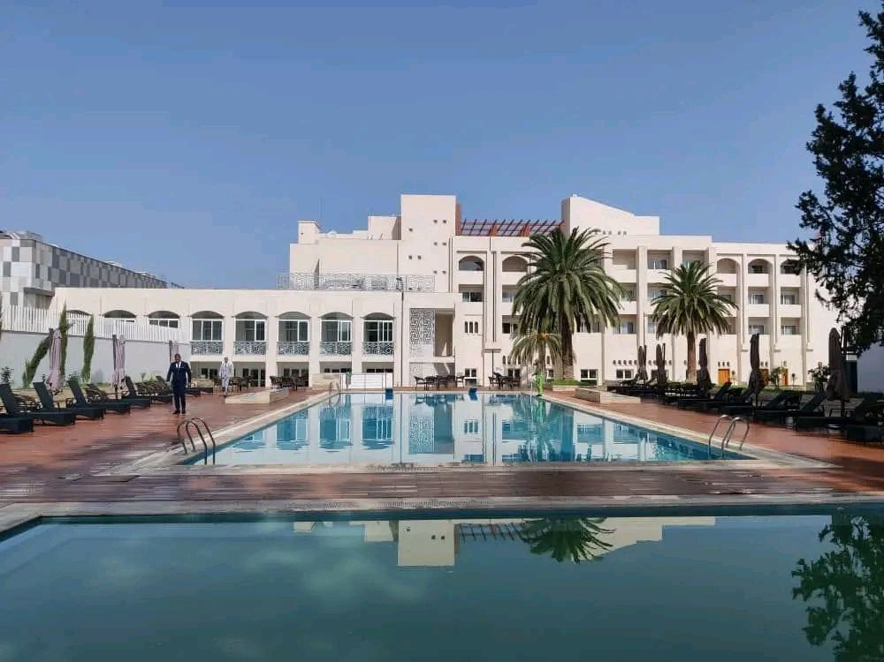

UNIVERSITÉ 8 MAI 1945 GUELMA
FACULTÉ DE MATHÉMATIQUES ET DE L'INFORMATIQUE ET
DE SCIENCES DE LA MATIÈRE
Hotel Chain
Hotel Mermoura
TEAM MEMBER:
BOURAGBI HADJER
LAHOUACHE OUMAIMA
GUETTAF MALAK
MEZGHACH ABDOULLAH
AIDOUD CHAHED
DOUDOU AMIRA AICHA
SUPERVISOR
OUARETH SELMA

Slide 2
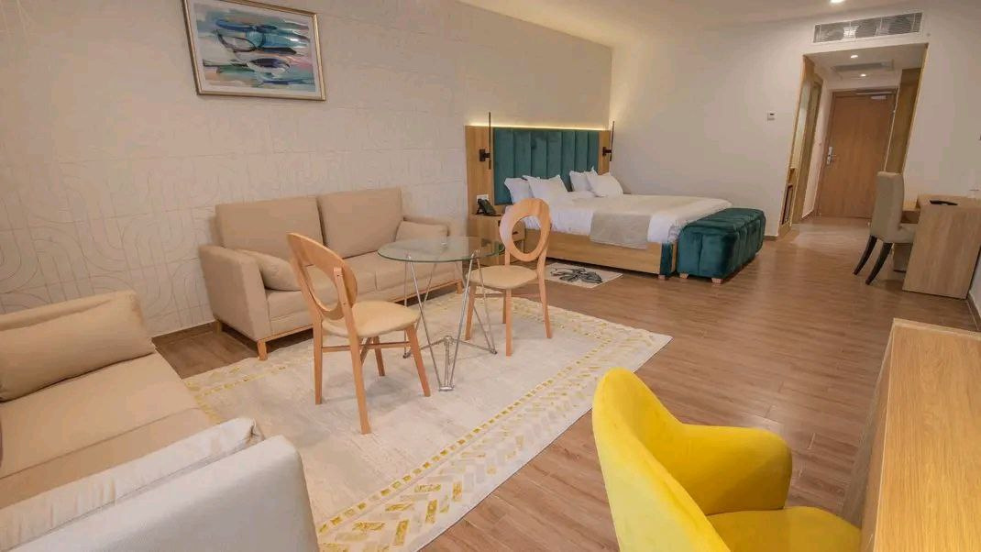

INTRODUCTION
Overview
This project was inspired by our internship at HOTEL MERMOURA, where we noticed the need for a better reservation system.
We created a simple and efficient website to help the hotel manage bookings easily and improve customer experience.

Slide 3
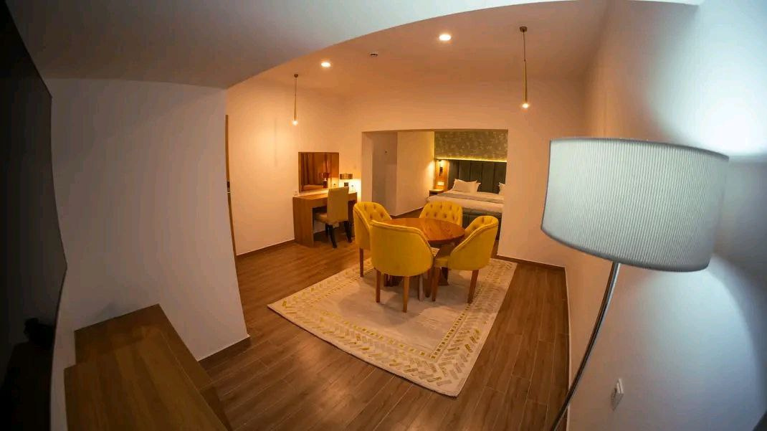
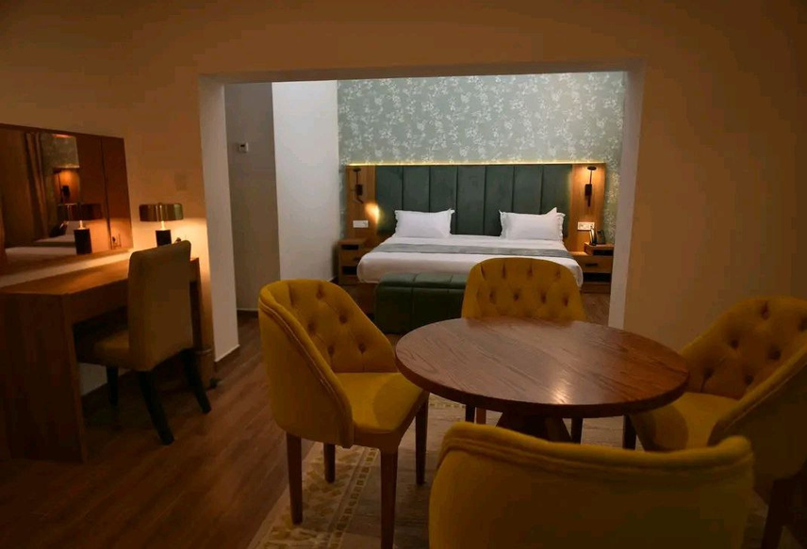
PROBLEMATIC
About Us
During our internship at HOTEL MERMOURA, we identified several issues in how the hotel handled reservations:
All bookings were done manually using paper records.
High risk of double bookings and lost reservations.
No easy way to check room availability in real-time.
Lack of customer communication (no automatic confirmation).
The staff spent a lot of time handling repetitive booking tasks.
No central system to manage client information or booking history.
These problems motivated us to create a digital solution:
➡️ A website that makes hotel reservations easier, faster, and more reliable.

Slide 4
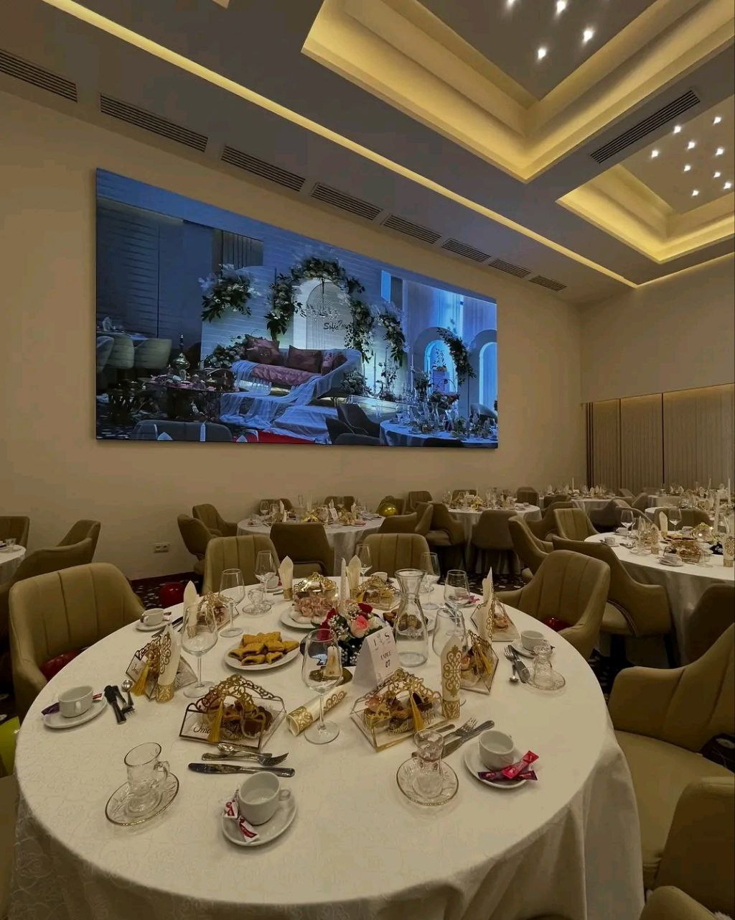

FUNCTIONALITIES
Our Mission
OUser Registration and Login
Room Browsing and Availability
Online Booking Form
Email Confirmation System
Client Account Dashboard
Admin Panel for Room Management
Reservation History View
Contact and Feedback Form
Real-time Availability Calendar
Secure Data Storage and Access

Slide 5
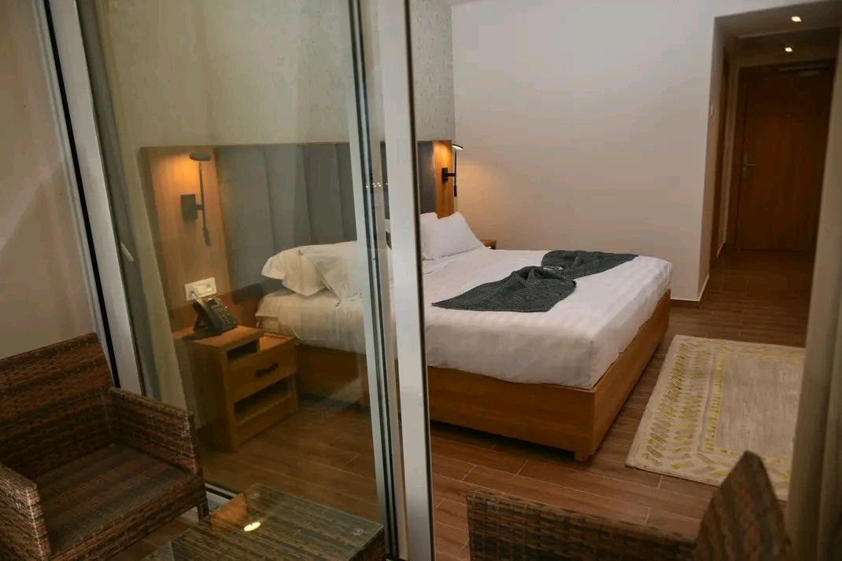

CONCLUSION
Conclusion
We worked on this project to help HOTEL MERMOURA with their booking problem.
Now, they can take reservations online in an easy and fast way.
This experience helped us learn new skills and work better together as a team.

